Slide 1
Scan context & scan context++
2022.07.21
강경수

Slide 2
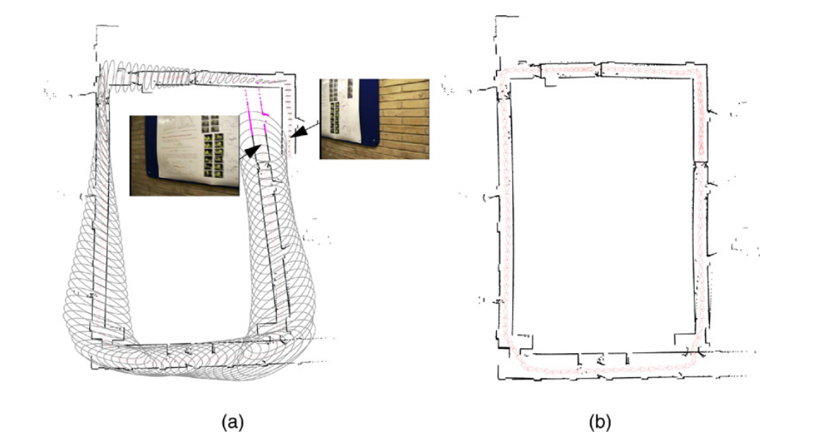
Topic – scan context
2 /
- how to detect loop
Visual-base Loop close detection
: bag of word, HOG, NetVLAD
Previous Lidar-base Loop detection
: histogram-base
➔ can False positive loop detect
For slam, need to loop closing
How?

Slide 3
Motivation & contribute
3 /
- Scan Context
For correct loop detection,
descriptor need structure of the scene
Contribution (1). Efficient bin encoding function
- invariance to density and normal of point cloud
(2). Preservation of internal structure of a point cloud
- invariance of rotation through structure information
(3). Effective two-phase matching algorithm
- reduce search time

Slide 4
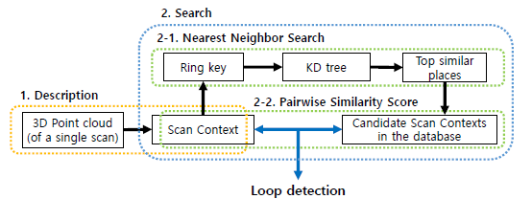
Scan Context
4 /
- overview
Pre-search
Make scan context
Loop closing verification

Slide 5
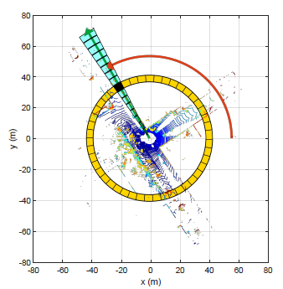


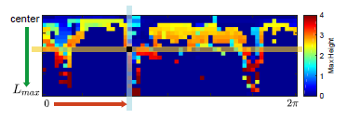
Scan Context
5 /
- Make scan context
projection 3D point cloud
Separated ring & sector
Each bin’s value is maximum height
sector
ring

Slide 6
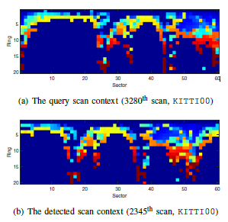


Scan Context
6 /
- Similarity score between scan context
Columnwise cos distance summation
Column-shifted scan context & Find min d
n* is rotation value from before

Slide 7
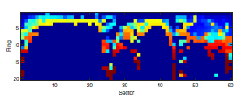

Scan Context
7 /
- Two phase search
First phase – NN search
key
Each ring’s normalize L0 norm
Key is $N_{r}$- dimensional vector
Second phase – pairwise distance scoring
- similarity score between scan context
By two phase search, Reduce search time

Slide 8
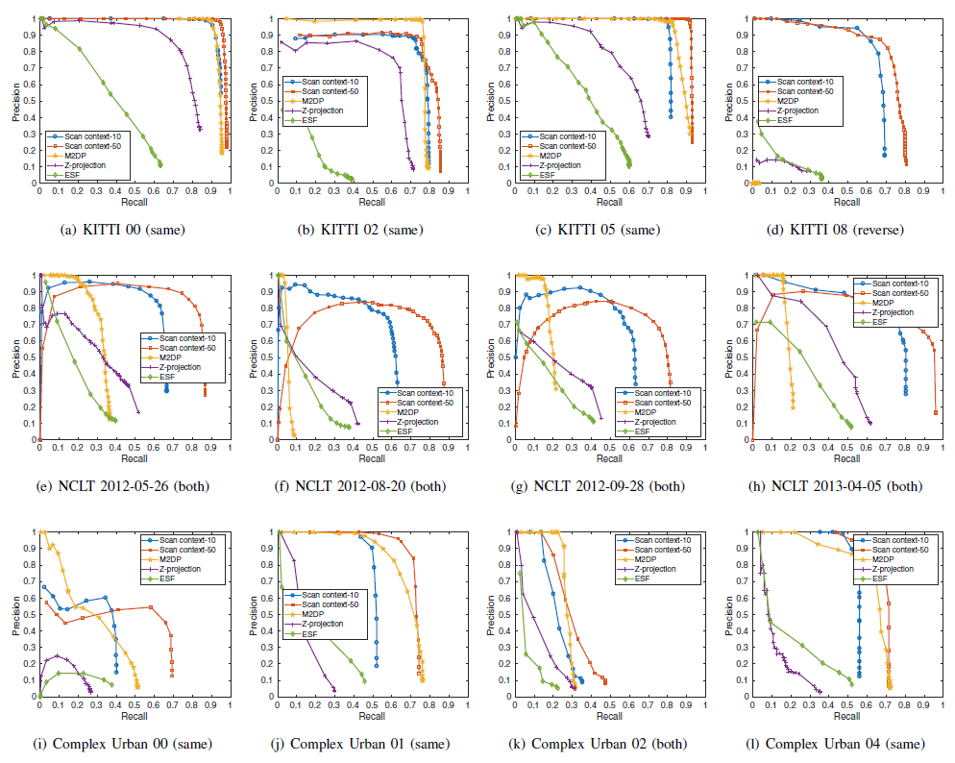
Scan Context
8 /
- experiment

Slide 9
Topic – scan context++
9 /
- Metric & topological
Loop closing
Transform from A to B?
B
A

Slide 10
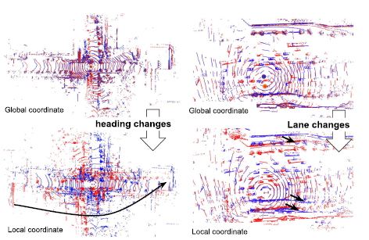
Topic – scan context++
10 /
- Robust rotation & translation
loop closing is successfully detection
So, where robot’s precise localization?
Need metric localization

Slide 11
Motivation & contribute
11 /
- Scan context++
Contribution (1). Robustness to Lateral/Rotational Changes
- invariance rotation & translation
(2). Semi-metric Localization
- bridges between topological and metric localization
(3). Lightweight and Modules independence
(4). Real-time performance on CPU
- use submap (Retrieval Key, Aligning Key)

Slide 12
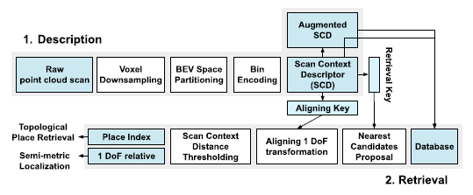
Scan Context++
12 /
- overview
Pre-search
Make scan context++
Loop closing verification

Slide 13
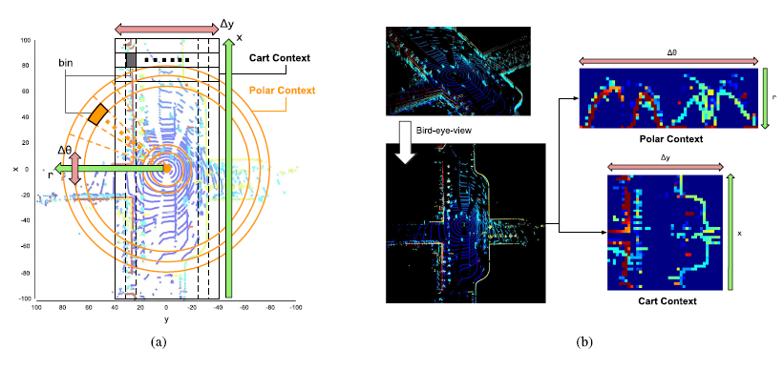
Scan Context++
13 /
- Make scan context++
Make scan context Polar coordinate & cart coordinate
Polar coordinate is invariance Rotation
cart coordinate is invariance translation

Slide 14
Scan Context++
14 /
- Distance
Same scan context

Slide 15
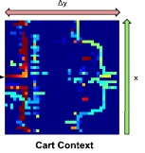
Scan Context++
15 /
- Make subdescriptors
Each row vector L1 norm
Like context’s ring key, retrieval key is used pre-search
Retrieval key
Aligning key
Aligning key is used rotation/translation value from before
Each Column vector L1 norm

Slide 16
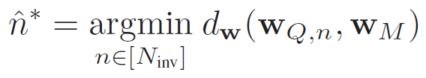


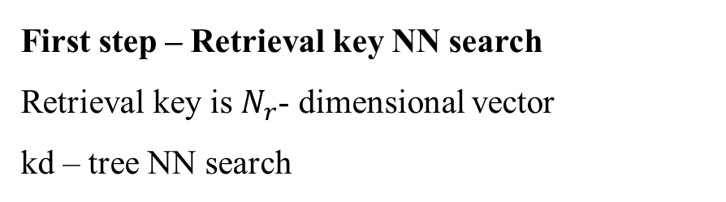
Scan Context++
16 /
-Three stage place recognition
First step – Retrieval key NN search
Retrieval key is $N_{r}$- dimensional vector
kd – tree NN search
Second step – Aligning key (min L2 norm)
Third step – reject false positive

Slide 17
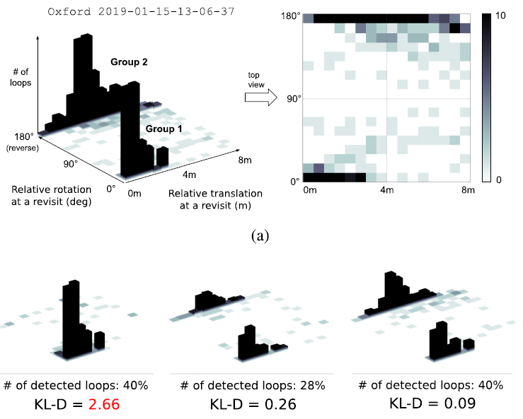
Scan Context++
17 /
- Experiment
KL - Divergence

Slide 18
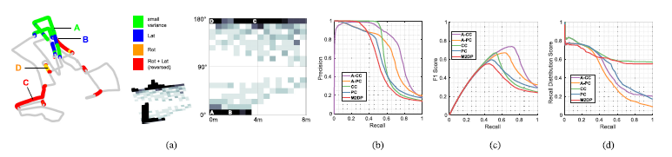
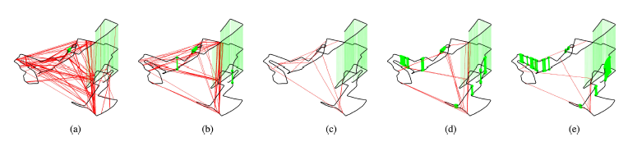
Scan Context++
18 /
- Experiment

Slide 19
Q & A.
19 /

